Slide 1
Air Education and Training Command Office of the Staff Judge Advocate 2018 Leadership Summit
Lt Col Jason Robertson
AETC/JA
26 September 2018

Slide 2
SJA Time management tips
(this is also a section divider slide example)

Slide 3
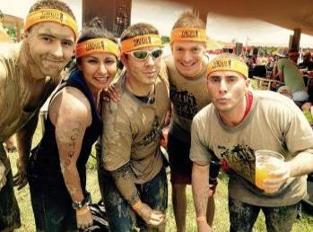
5. Stop Running…Make a Plan
What do you have to do?
Article 6, Attachment 3, MICT
How will you do it?
Meeting? Training? Letter?
How will you prove it?
Inspections – can’t prove it, it did not happen
Can it run without you?
Repeatable, structured

Slide 4
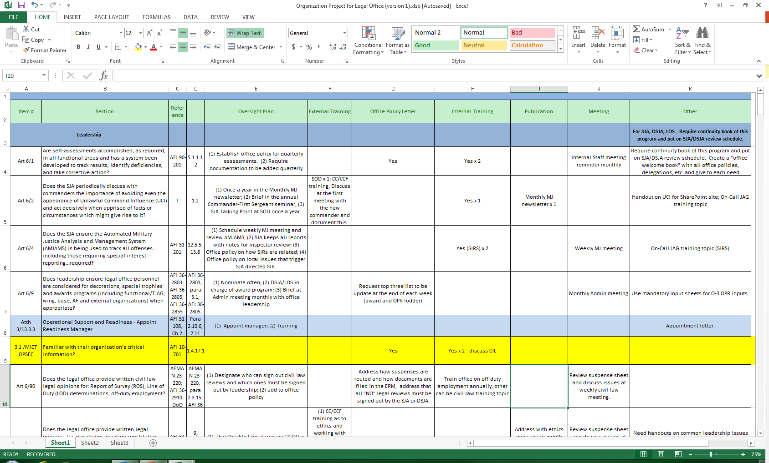
5. Stop Running…Make a Plan

Slide 5
5. Stop Running…Make a Plan
Defines my “MUST-HAVES”
Meetings
Office Policy Letter
Subjects for Training Program
External Trainings and Topics
Publications/Handouts
Appointment letters

Slide 6
What are MY MUST Haves?
Working ERM
Working suspense system
Staff Meeting
Short-burst training
MJ meeting
Admin Meeting
Civil Law Meeting
CL Newsletter
MJ Newsletter
SharePoint site for CC/CCFs
CC/CCF Seminar
CC/CCF Handouts
LA Handouts
Top 3 Things taskers
Job Jars for ALL
LA Prescription Pad
Labeled Duties/Meetings
CGO OPR Input Sheets
“My Office” Booklet
Office 101 orientation
Policy Letters
Shared calendar
Ed block at SOD
Monthly Cont book review policy
100% Shred policy
Morning PT policy
VWAP Report
Court Reporter ROT Status
TC Assignment/Certification
Award or Kudos Plan

Slide 7
4. Respect Time – and teach that
Never have a meeting without a clock
What DO you need from the meeting?
End meetings on time and re-schedule
Announce when you are leaving – and teach them to plan around that
Train them to work with your time in mind
Your leaving will create a deadline

Slide 8
Meetings
Office Meetings
Morning Stand-up OR Regular Full Meeting
Agenda (formal or informal)*
Slides* or a handout
Office Projects
Personnel Updates
Top Three from Civil Law and MJ
Short-burst (5-7 min)*
Safety Updates*
Deadlines
ONS Review with DSJA
Around the Room
Kudos/Praise in Public
Office Introductions
Centralized slides. Make others responsible for parts.

Slide 9
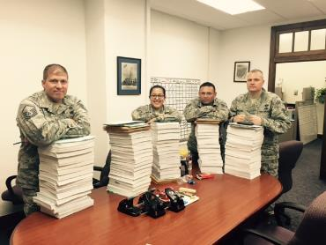
Meetings
Military Justice (Folder)
Training – Spotlight/Short-burst
Have an AMJAMS folder*
Determine what YOU need
Cheat Sheet/Calendar
Court Reporter Report
VWAP Report*
Certification Report/TC assignments*
Always ready when MAJCOM calls…

Slide 10
Meetings
Civil Law (Folder)
Have Agenda – follow it
What information do YOU need?
Training/Short burst
Legal Assistance/Honor Roll status
CDIs in the office log
AFCIMS
Suspense Program
Mag Court update
Labor and Employment
If you want to be the hero of Squadron commander or First Shirt, work in Military Justice. If you want to be the hero of a Wing CC, work in Civil Law!

Slide 11
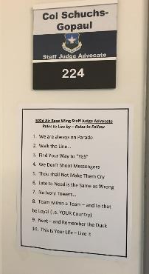
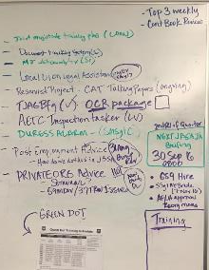
3. Release Your Inner Action Officer
Delegate – invest in training them
Set priorities, TEACH priorities
FOIA vs. LOD, Court vs. LA
White Board (section or office)
Solid Suspense system –
Solid Distribution system
Top Three Things
Give the RULES

Slide 12
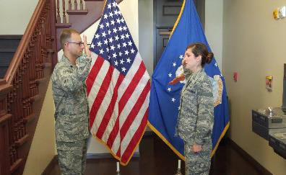
2. Organize Yourself
Tracking
Job Jar for LOS and DSJA
To Do List (of course)
Top Three note to Yourself
Calendar - Shared and Office
Leave, Reservists, TDYs, Hearings
Dedicated Notebook for Meetings
Prepared for the Sudden
Program Your Phone
PDF the important stuff
Have SJA Book and Exercise/CAT Book

Slide 13
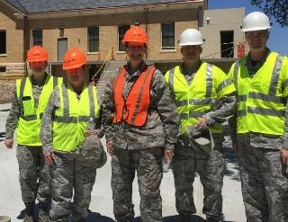
1. Email is a TOOL – not a lifestyle
Do not let email set YOUR priorities
Do your Boss’ Work First
Set a Google Alert
Folders System will SAVE
No “Land of Red Flags”
Put deadlines for others on your
calendar

Slide 14
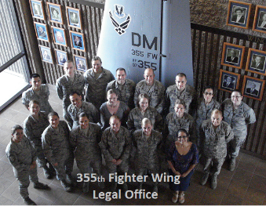
Some of my favorite things…
Build systems…answer inspections…move faster
I don’t know what…(refresh twice a year)
“My DM” Book for office
JBSA JA 101
We need more for…award, dec, eval
Top Three Things Weekly for All
Need speed…Mandatory OPR Form
What is expected of me…
Job Jar exercise (give “expert” status…)
Schedule Standard and Expectation Jan/Aug

Slide 15
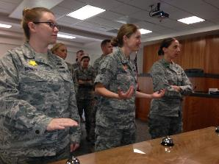
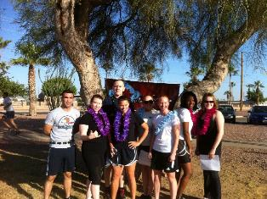
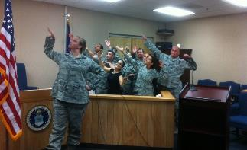
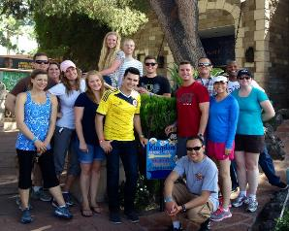
Organizing the Office
TRAINING…no time?
SJA Training Plan with feedback*
Short-burst*
Depressed LA Client…
LA Prescription Pad*
CCs doesn’t know…
“Power Sheets” for CC
Targeted Handouts* (SharePoint)
Teach at SOD – sign in roster

Slide 16
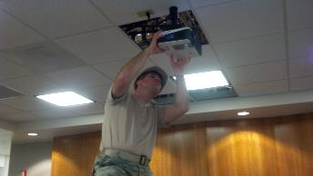
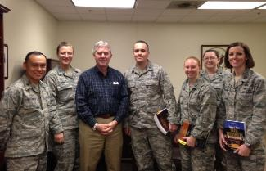
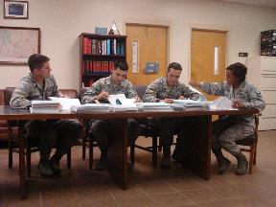
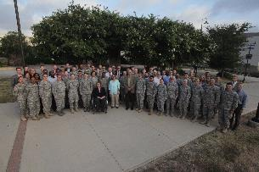
Organizing the Office
Who is responsible for…
Label the Offices (Add’l Duties)
No time for PT…
0830 Report Time after PT
Going on for years…
Big Base Issue Civil Law Files
What is happening in my case
Friday emails to SQ CC/CCF
Know the office
Team building saves time
Build pride – JAG Family News

Slide 17
Questions?

