Slide 1
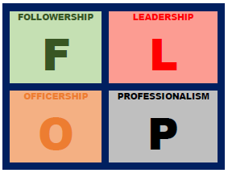
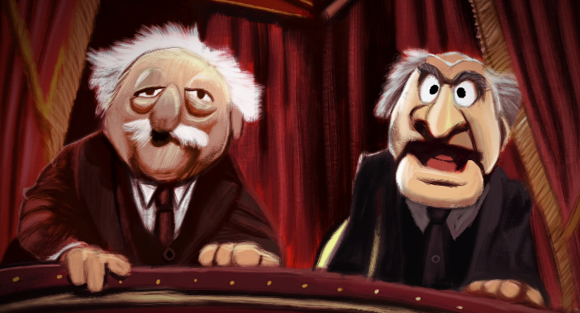
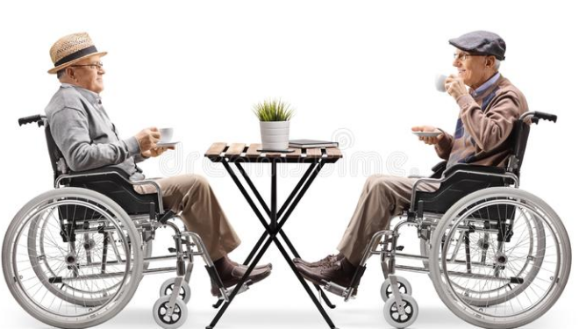
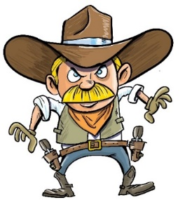
The Third Air Force FLOP Club &
Air Force District of Washington present…
Two+ Old JAGs Chatting Over Coffee
Col Kevin Catron Col BT Thompson
AFDW/SJA 3AF/SJA
f/t Col Mark Hoover, AFJAGS
Capt Joey Klein, 100 ARW
Capt Bryan Bowyer, 48 FW

Slide 2
Two+ Old JAGs Chatting Over Coffee
The “Two+ Old JAGs” who will be “Chatting Over Coffee”
BT: Wg DSJA, JB SJA, AOR SJA, NAF SJA
Catron: Wg DSJA, “Wg” SJA/CC, Wg SJA, JB SJA [LOOTY], NAF-COM SJA
Hoover: Grp/Wg/NAF DSJA, Wg/Ctr SJA [LOOTY], Commandant AFJAGS
The Why and The How of Today’s Principles
Find them: www.the-cole.com/leadership
The 12 Principles
The Poll
The Playout

Slide 3
The 12 Principles
(1) Lead From the Front
(2) Leadership First, Management Second
(3) Always Take Care of Your Team
(4) Great Leaders are Great Followers
(5) Leaders are Grown, Not Born
(6) Leaders Foster a Culture of Respect
(7) Lead From the Rear
(8) Leadership Starts with a Vision
(9) Leaders Must Be Proactive, Not Reactive
(10) The Art of Communication is the Language of Leadership
(11) Be Decisive
(12) Leaders Should Always Take Care of Their Boss

Slide 4
The 12 Principles
(1) Lead From the Front
(2) Leadership First, Management Second
(3) Always Take Care of Your Team
(4) Great Leaders are Great Followers
(5) Leaders are Grown, Not Born
(6) Leaders Foster a Culture of Respect
(7) Lead From the Rear
(8) Leadership Starts with a Vision
(9) Leaders Must Be Proactive, Not Reactive
(10) The Art of Communication is the Language of Leadership
(11) Be Decisive
(12) Leaders Should Always Take Care of Their Boss

Slide 5
THEORY
#1
“Lead from the front”
You must “show” and “do” not just “tell,” you must be willing to get into the trenches, set the example, model the motto: Everybody Works, Everybody Works Everything
MEANING
PRACTICE
- Col BT Examples:
-- Wg DSJA = Legal Assistance & CMs
-- Chief STC = Litigate & administrate
-- Chief SAF/IGS = Case Intake, Investigation Counsel
-- NAF/SJA = Proofs, SALRs, GCMCA Rvws, Legal Rvws
- Take the newbies to a meeting before unleashing them on their own
- “Market” your vision [The Helpful NAF™, The Center of Litigation Excellence] … INSPIRE
- Visit each teammate each day (each morning) & ask how you can help make their life easier
- Track changes on all product they provide to you and walk them through reasons for edits/changes … FEEDBACK
- Don’t shirk the hard conversation w/a CC or Shirt (or your bosses)
- Develop a leadership philosophy and writing guide (preferences)
- Set a “de-brief culture” … ask teammates how you could have handled a situation differently/better
-- “I met with Col X on and discussed Case A, I told him ABC, wasn’t the best answer, what’s a better answer?”
The Swoosh Principle
The work you don’t have to do because you’re [Chief of X] … Just Do It.

Slide 6
The 12 Principles
(1) Lead From the Front
(2) Leadership First, Management Second
(3) Always Take Care of Your Team
(4) Great Leaders are Great Followers
(5) Leaders are Grown, Not Born
(6) Leaders Foster a Culture of Respect
(7) Lead From the Rear
(8) Leadership Starts with a Vision
(9) Leaders Must Be Proactive, Not Reactive
(10) The Art of Communication is the Language of Leadership
(11) Be Decisive
(12) Leaders Should Always Take Care of Their Boss

Slide 7
THEORY
“Lead From the Rear!”
This is NOT abrogating your leadership responsibilities; this is empowering people to make decisions, to harness your team’s talent.
MEANING
Step 1: Before leading from the rear, you have to know the strengths and weaknesses of your team, where your team is, and where you want to go; it’s not enough to say, “you got this!”
Use your Vision (see Theory #8) to guide your team from the rear
NOT an automatic style of leadership
Step 2: Your goal is to divest control of your team by increasing your clarity of expectation and the team’s competence (training)
Make sure your team understands what you find important and ensure they’re trained to do the job! Unsure? Find someone who CAN train them!
Step 3: Implement! Tips:
During meetings, seek input & give speaking roles; give team chance to brief CC or SJA (think SOD, etc); let them author/sign legal reviews
PRACTICE

Slide 8
The 12 Principles
(1) Lead From the Front
(2) Leadership First, Management Second
(3) Always Take Care of Your Team
(4) Great Leaders are Great Followers
(5) Leaders are Grown, Not Born
(6) Leaders Foster a Culture of Respect
(7) Lead From the Rear
(8) Leadership Starts with a Vision
(9) Leaders Must Be Proactive, Not Reactive
(10) The Art of Communication is the Language of Leadership
(11) Be Decisive
(12) Leaders Should Always Take Care of Their Boss

Slide 9
THEORY
#2
“Leadership first, management second”
“The manager administers; the leader innovates. The manager has a short-range view; the leader has a long-range perspective. The manager asks how and when; the leader asks what and why. The manager has his eye on the bottom line; the leader has his eye on the horizon. The manager accepts the status quo; the leader challenges it.” - Warren G. Bennis
“Great leaders can be great managers, but the reverse is not always true.” – Col BT
MEANING
PRACTICE
- Work the vision piece first, and then work processes to match … those are separate LOEs
-- Col BT Example: Vision (an admin-lite NAF) then blow-up/revise processes to effect vision
- Blow-up Meetings: One process at a time (NJP): (1) gather data to know where you’re at, (2) challenge team to be ready to create the perfect process, (3) set uninterrupted time aside, (4) put aside all LIMFACs; (5) ask “why” doing what you’re doing; (6) create “perfect” process; (7) identify LIMFACs and why they are and how to overcome/manage; (8) document, set milestones, and execute
- If everything is important, nothing is important: discuss/set priorities for team/members every day
-- “What are you working today?” … “Great, let’s focus on X because Y, and push A because of B. That work?”

Slide 10
The 12 Principles
(1) Lead From the Front
(2) Leadership First, Management Second
(3) Always Take Care of Your Team
(4) Great Leaders are Great Followers
(5) Leaders are Grown, Not Born
(6) Leaders Foster a Culture of Respect
(7) Lead From the Rear
(8) Leadership Starts with a Vision
(9) Leaders Must Be Proactive, Not Reactive
(10) The Art of Communication is the Language of Leadership
(11) Be Decisive
(12) Leaders Should Always Take Care of Their Boss

Slide 11
THEORY #8
“Leadership starts with a vision!”
As a leader you must have a roadmap or plan for success that others: (1) understand, and (2) can get behind
MEANING
Step 1: What are the strengths and weakness of your section? Find ways to improve/innovate processes or metrics
This process starts with you, the leader, but include your team’s input = buy-in!
Step 2: Where do you want to take your section? You need goals
Goals need to be: (1) clear, (2) easily understood by all, (3) measurable, (4) achievable
Here, include more team inputs = make the goals their goals
Print them or make them visible to the team; incorporate them into normal daily ops
Re-visit them often and measure your success = course correct and stay focused
Step 3: Instill a competitive spirit! This is the art of influence through motivation
Step 4: Celebrate success; recognize top performers, ring a bell for a win, ask SJA/LOS to give a shout-out during a staff meeting, submit for things like “Top 3 Performer”
PRACTICE

Slide 12
The 12 Principles
(1) Lead From the Front
(2) Leadership First, Management Second
(3) Always Take Care of Your Team
(4) Great Leaders are Great Followers
(5) Leaders are Grown, Not Born
(6) Leaders Foster a Culture of Respect
(7) Lead From the Rear
(8) Leadership Starts with a Vision
(9) Leaders Must Be Proactive, Not Reactive
(10) The Art of Communication is the Language of Leadership
(11) Be Decisive
(12) Leaders Should Always Take Care of Their Boss

Slide 13
THEORY
#3
“Always take care of your team”
“The secret to success in life and success as a leader is to take and give every opportunity to excel.” – Col BT
“Take care of your team and your team will take care of you.” - Col BT’s Dad
MEANING
PRACTICE
- Do not think of your folks as your “people” or your “subordinates” they are your team/teammates.
- Unless impossible, never pass up giving your teammates an opportunity to excel (O2E)
-- Paralegals: Asst Recorder Admin Bds; Drafting Proofs; Trainings (attending/presenting)
-- All: PROJOs; Deployments/TDYs; Meet with CCs; Authorship (co-sign)
-- Go sit with LOS, ask: “How can I take care of SSgt X and A1C Y’s professional development, what are some O2E?”
- Nothing motivates like you taking a genuine (or well-feigned) interest in your teammates’ interests.
-- Find out interests, and learn about ones you don’t know. Col BT example: NASCAR, Bass Fishing
- Recognition: Obviously awards [develop noms early] but also …
-- Stickies Wall of Fame
-- Highlight at briefings/HHQ visits: “Gen X, I’m going to have SSgt A brief you on Z. SSgt A is an awesome part of our team because …”
- Feedback and accountability [your team craves constructive criticism, feedback]
-- “Yep, we screwed that up, let’s talk about how we can do better the next time.”

Slide 14
The 12 Principles
(1) Lead From the Front
(2) Leadership First, Management Second
(3) Always Take Care of Your Team
(4) Great Leaders are Great Followers
(5) Leaders are Grown, Not Born
(6) Leaders Foster a Culture of Respect
(7) Lead From the Rear
(8) Leadership Starts with a Vision
(9) Leaders Must Be Proactive, Not Reactive
(10) The Art of Communication is the Language of Leadership
(11) Be Decisive
(12) Leaders Should Always Take Care of Their Boss

Slide 15
THEORY
#9
“Leaders must be proactive, not reactive”
If you’re focusing on the day’s problems, you’re missing 50% of your leadership potential
MEANING
PRACTICE
Step 1: Adopt the mindset of failing now … to succeed in the future; you won’t be able to solve problems before they happen, but you can be prepared
E.G., if your MJ processes are broken, rather than run in circles and tread water, eat the metrics and put 100% of your energy into tactical-level training (hint: doesn’t have to be you conducting the training) … then you’ll be successful
Step 2: Manage your manning calendar! People go TDY, have courts, take leave … none of that should be a surprise; work to fill gaps with leadership
Step 3: Identify what the wing’s hot issues and work to help address them Step 4: Take care of your people
Understand where the paralegals are in upgrade training / education = motivate them
Rotating into a new job? Get them ready to assume new duties

Slide 16
The 12 Principles
(1) Lead From the Front
(2) Leadership First, Management Second
(3) Always Take Care of Your Team
(4) Great Leaders are Great Followers
(5) Leaders are Grown, Not Born
(6) Leaders Foster a Culture of Respect
(7) Lead From the Rear
(8) Leadership Starts with a Vision
(9) Leaders Must Be Proactive, Not Reactive
(10) The Art of Communication is the Language of Leadership
(11) Be Decisive
(12) Leaders Should Always Take Care of Their Boss

Slide 17
THEORY
#4
“Great leaders are great followers”
“Be the Follower who you as a Leader would want following you.” – Col BT
[1] Convincing your Leader to choose the best course of action (COA)
[2] Making the chosen COA happen, regardless if it is the one you advocated
for or would have chosen.
MEANING
PRACTICE
- [1] A Follower should keep pushing until they are told no or to stop. But force the feedback discussion
-- Too hard: “Sometimes I feel like I push too hard when I think I am right, do I come across as disrespectful?”
-- Too easy: “I’m worried I’m not adding value to the office, not doing enough to make it better even though I have all of these ideas, how do I do better?”
- COAs: Staff package: (1) written proposal in detail, 5W’s+H; (2) Multiple COAs+ pros/cons; (3) implementation plan and attachments (references); (4) professionally packaged (hard copy or electronic); (5) sent to Leader with an Outlook Meeting Request
- [2] ≠ “I know this is not a popular decision that X made but we have to execute.”
= “Here is the way forward and here’s the way I think we can best execute.”

Slide 18
The 12 Principles
(1) Lead From the Front
(2) Leadership First, Management Second
(3) Always Take Care of Your Team
(4) Great Leaders are Great Followers
(5) Leaders are Grown, Not Born
(6) Leaders Foster a Culture of Respect
(7) Lead From the Rear
(8) Leadership Starts with a Vision
(9) Leaders Must Be Proactive, Not Reactive
(10) The Art of Communication is the Language of Leadership
(11) Be Decisive
(12) Leaders Should Always Take Care of Their Boss

Slide 19
THEORY #10
“The art of communication is the language of leadership”
Communicating is not telling people what to do, it includes fostering a culture of transparency while setting clear expectations both up and down the chain of command
MEANING
PRACTICE
Step 1: When communicating to your team, follow four principles: (1) What do I know?, (2) Who needs to know it?, (3) How do I get them the information, and (4) Did they receive … and understand?
Step 2: Figure out if your team prefers email or verbal information
Step 3: Learn to deliver feedback; always find ways people can improve; look them in the eyes
Step 4: Never send an emotional email … and always assume your email will be misinterpreted … and forwarded
And always assume walking down to deliver information in person is a better method
Step 5: When speaking in public (brief, training, SOD, etc) always practice and be ready
Large part of communicating is confidence = if you lack it (will gain with practice) your message is lost

Slide 20
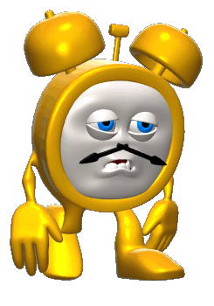
The 12 Principles
(1) Lead From the Front
(2) Leadership First, Management Second
(3) Always Take Care of Your Team
(4) Great Leaders are Great Followers
(5) Leaders are Grown, Not Born
(6) Leaders Foster a Culture of Respect
(7) Lead From the Rear
(8) Leadership Starts with a Vision
(9) Leaders Must Be Proactive, Not Reactive
(10) The Art of Communication is the Language of Leadership
(11) Be Decisive
(12) Leaders Should Always Take Care of Their Boss

Slide 21
THEORY
#5
“Leaders are grown, not born”
“Leaders aren’t born, they are made. And they are made just like anything else, through hard work.” – Vince Lombardi
“Leadership cannot really be taught. It can only be learned.” – Harold Geneen
“All animals are equal, but some animals are more equal than others.” – The Pigs of Manor Farm
MEANING
PRACTICE
- [1] Understand that, regardless of how much practice you’ve had, you’re still not the perfect leader.
-- “Art”: Beauty is in the eye of the beholder; what works for one probably won’t work for all.
-- “Science”: Some general leadership principles are timeless, e.g., consistency, honesty, etc.
- [2] Improving your leadership skills takes effort…and time.
-- Take a proactive learning approach; utilize self-improvement resources & develop your style.
-- Seek out both formal (e.g., CGOC) & informal (e.g., office cleaning) leadership opportunities.
-- Ask for honest feedback from superiors & subordinates (at the proper times).
- [3] Learn from your leadership failures (if you don’t fail, you’re not trying).
-- Make a conscious effort to adjust your style, as needed.
-- Pass on your lessons learned to others (but don’t pretend that you know everything).

Slide 22
The 12 Principles
(1) Lead From the Front
(2) Leadership First, Management Second
(3) Always Take Care of Your Team
(4) Great Leaders are Great Followers
(5) Leaders are Grown, Not Born
(6) Leaders Foster a Culture of Respect
(7) Lead From the Rear
(8) Leadership Starts with a Vision
(9) Leaders Must Be Proactive, Not Reactive
(10) The Art of Communication is the Language of Leadership
(11) Be Decisive
(12) Leaders Should Always Take Care of Their Boss

Slide 23
THEORY #11
“Be decisive!”
This is NOT making off-the-cuff decisions or pretending to know it all
MEANING
PRACTICE
Step 1: Self reflect and know yourself! Do you require a lot of information before you reach a conclusion? Like to say the first thing that pops into your mind?
Both have pros/con – find balance
Ask your teammates: “how am I at making decisions?”
Step 2: Solicit input of others – you’ll be surprised what you missed
Increases communication and collaboration (Theory #10) and pushes team to solve problems (Theory #7)
Step 3: “Perfection is the enemy of progress” Learn to be comfortable making decisions with 80% of the data
Step 4: Block 30 minutes at the beginning of every day (or at the end) for task prioritization

Slide 24
The 12 Principles
(1) Lead From the Front
(2) Leadership First, Management Second
(3) Always Take Care of Your Team
(4) Great Leaders are Great Followers
(5) Leaders are Grown, Not Born
(6) Leaders Foster a Culture of Respect
(7) Lead From the Rear
(8) Leadership Starts with a Vision
(9) Leaders Must Be Proactive, Not Reactive
(10) The Art of Communication is the Language of Leadership
(11) Be Decisive
(12) Leaders Should Always Take Care of Their Boss

Slide 25
THEORY #6
“Leaders Foster a Culture of Respect!”
“Respect your fellow human being, treat them fairly, disagree with them honestly, enjoy their friendship, explore your thoughts about one another candidly, work together for a common goal, and help one another achieve respect. Don't use destructive lies, unfounded fears, or debilitating anger.” - Bill Bradley
“Don’t be a jackass.” - Col BT
MEANING
PRACTICE
- Go read AFI 1-2, Air Force Standards (¶3.2) … I’ll wait …
-- Opposite of AFI 1-2 = “Toxic Leadership” … Col BT’s definition
“Toxic leadership may be defined as a combination of self-centered attitudes, motivations, and behaviors that have adverse effects on subordinates, the organization, and/or mission performance. Toxic leaders may be bright and energetic, as well as goal-oriented and boss-focused. They are often capable of producing spectacular short-term results, but are often arrogant, abusive, intemperate, and distrusting. Toxic leaders are typically distrusting micro-managers and may never be burdened by introspection . Toxic leaders is often focus on personal criticisms of individuals rather than critiques of their professional performance, engage in discipline in public rather than in private, react disproportionately to perceived professional failures, and such acts are pervasive in nature rather than infrequent. Such behavior need not be intentional to have a negative impact on command climate.”

Slide 26
THEORY #6
“Leaders Foster a Culture of Respect!”
“Respect your fellow human being, treat them fairly, disagree with them honestly, enjoy their friendship, explore your thoughts about one another candidly, work together for a common goal, and help one another achieve respect. Don't use destructive lies, unfounded fears, or debilitating anger.” - Bill Bradley
“Don’t be a jackass.” - Col BT
MEANING
PRACTICE
- Go read AFI 1-2, Air Force Standards (¶3.2) … I’ll wait …
-- Opposite of AFI 1-2 = “Toxic Leadership” … Col BT’s definition
-- Fear of failure … fear of communicating failure … crushes positive culture
- Every person wants to feel valued:
-- “What do you think we should do here?”
-- “You’re great at X, can you show me how you do it?”
-- “What do you think your superpower is?”
-- “I don’t know anything about X, tell me what it means to you.”
- Infectiously positive and forward-leaning attitude, don’t dwell on the past (lawyers = sharks)

Slide 27
The 12 Principles
(1) Lead From the Front
(2) Leadership First, Management Second
(3) Always Take Care of Your Team
(4) Great Leaders are Great Followers
(5) Leaders are Grown, Not Born
(6) Leaders Foster a Culture of Respect
(7) Lead From the Rear
(8) Leadership Starts with a Vision
(9) Leaders Must Be Proactive, Not Reactive
(10) The Art of Communication is the Language of Leadership
(11) Be Decisive
(12) Leaders Should Always Take Care of Their Boss

Slide 28
THEORY #12
“Leaders Should Always Take Care of Their Boss”
Everyone in the Air Force has a boss. When your boss succeeds, it usually means you also succeed. But your support to your boss shouldn’t be conditioned on you receiving recognition or praise.
“‘But he has nothing on at all,’ said a little child at last.” – Hans Christian Andersen, The Emperor’s New Clothes
MEANING
PRACTICE
- [1] Figure out your boss’s priorities.
-- Don’t make it more complicated than needed...if he/she doesn’t highlight priorities, ask him/her.
-- Become familiar with DoD/DAF/TJAG priorities; figure out where you fit into the strategic picture.
- [2] Make them your priorities.
-- You’re always going to be juggling multiple tasks…focus on keeping the “glass balls” in the air.
-- Bad news doesn’t get better with age; don’t shy away from (tactfully) delivering the bad news.
-- Tell your boss what he/she needs to know, not what you think he/she wants to hear.
- [3] If in doubt about #1 or #2, ask your boss.
-- At a minimum, during formal feedback, ask how you’re doing with your boss’s priorities.
-- If you supervise personnel, don’t forget to share your aligned priorities with your subordinates.

Slide 29
The 12 Principles
(1) Lead From the Front
(2) Leadership First, Management Second
(3) Always Take Care of Your Team
(4) Great Leaders are Great Followers
(5) Leaders are Grown, Not Born
(6) Leaders Foster a Culture of Respect
(7) Lead From the Rear
(8) Leadership Starts with a Vision
(9) Leaders Must Be Proactive, Not Reactive
(10) The Art of Communication is the Language of Leadership
(11) Be Decisive
(12) Leaders Should Always Take Care of Their Boss

Slide 30
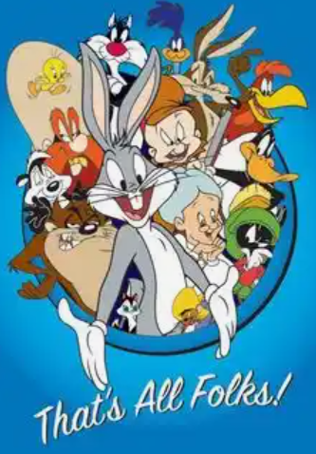
Two+ Old JAGs Chatting Over Coffee

